Slide 1
Benefits Of Reading Boks
SlideMake.com

Slide 2
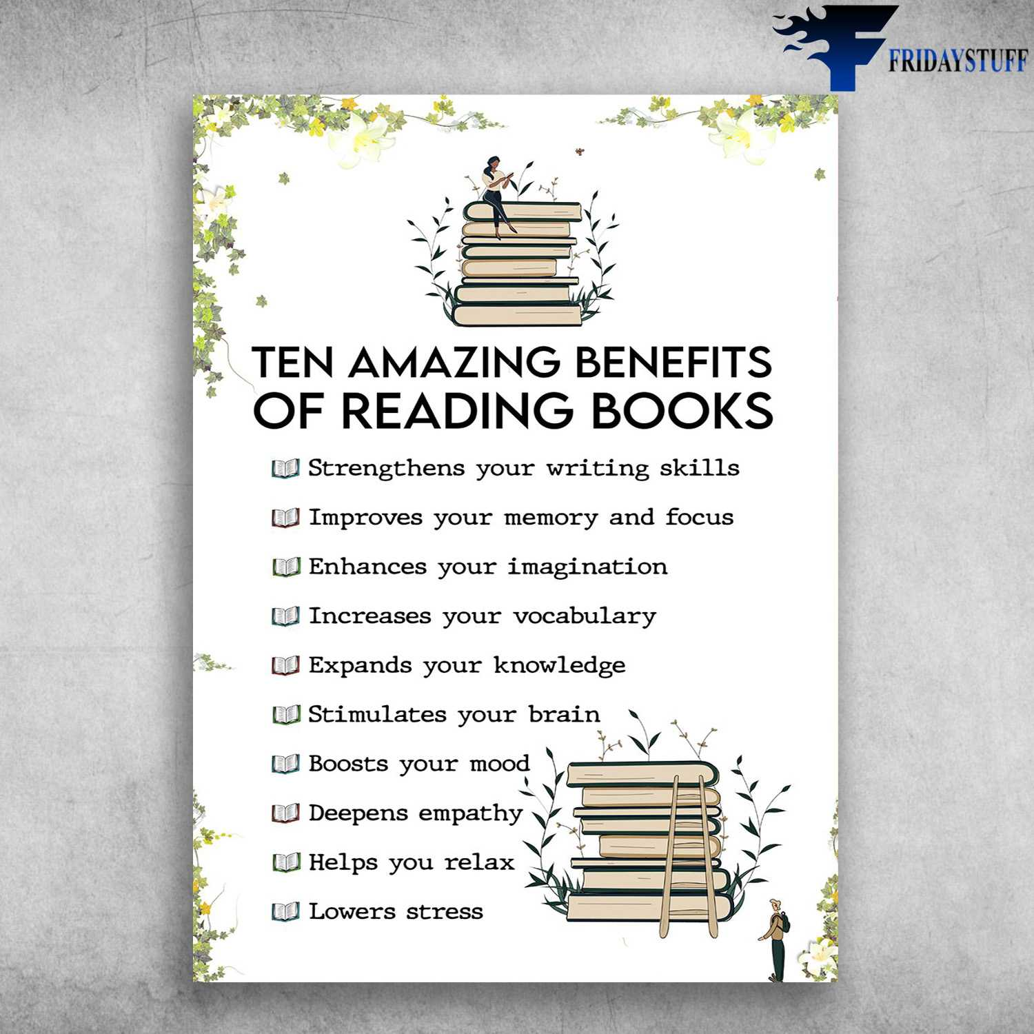
Introduction to the Benefits of Reading Books
Reading books is a fundamental skill that enhances knowledge and personal growth.
Engaging with written material can improve cognitive functions and critical thinking.
This presentation will explore various benefits associated with reading books.
Notes:
Image source: https://fridaystuff.com

Slide 3
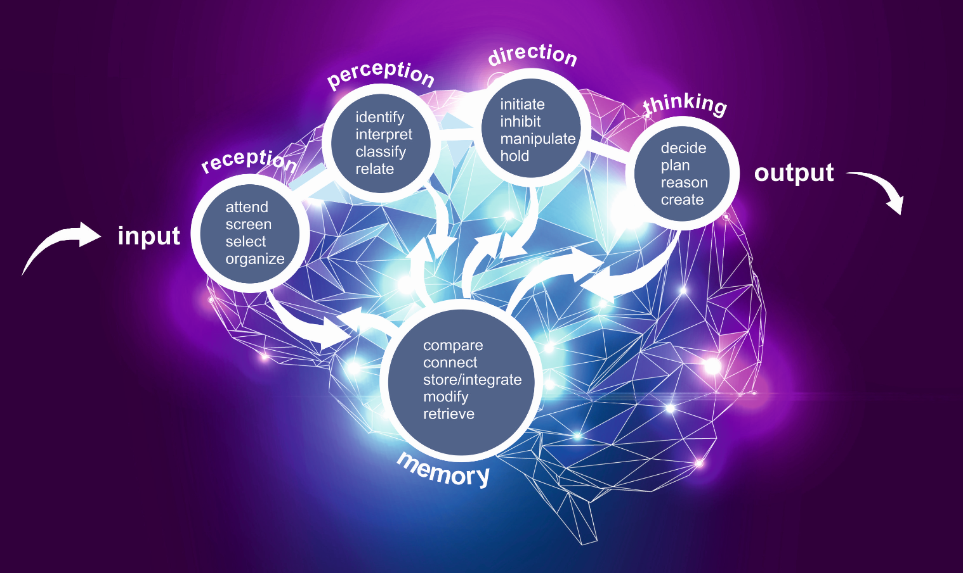
Cognitive Development
Reading enhances brain function by stimulating neural connections and improving memory.
It also boosts vocabulary and language skills, leading to better communication.
Regular reading can delay mental decline as we age, keeping the mind sharp.
Notes:
Image source: https://mybrainware.com

Slide 4
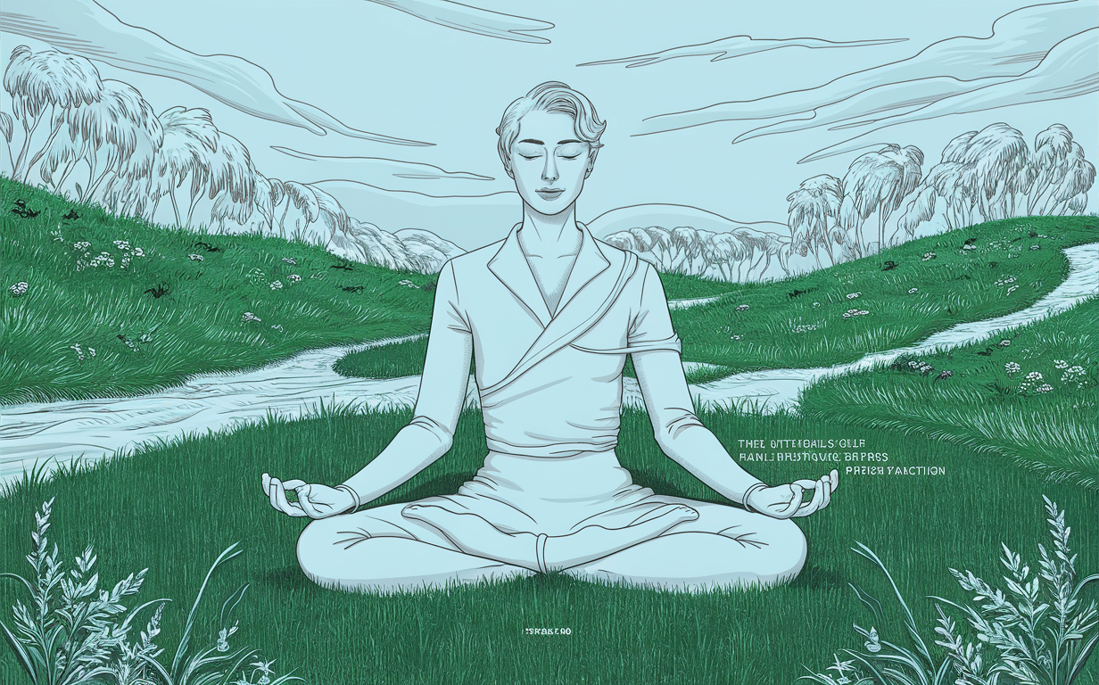
Emotional Well-being
Books can provide an escape from reality, reducing stress and promoting relaxation.
Engaging with diverse characters and stories cultivates empathy and emotional intelligence.
Reading can serve as a form of self-reflection, helping individuals understand their own emotions.
Notes:
Image source: https://charlestonchirostudio.com

Slide 5
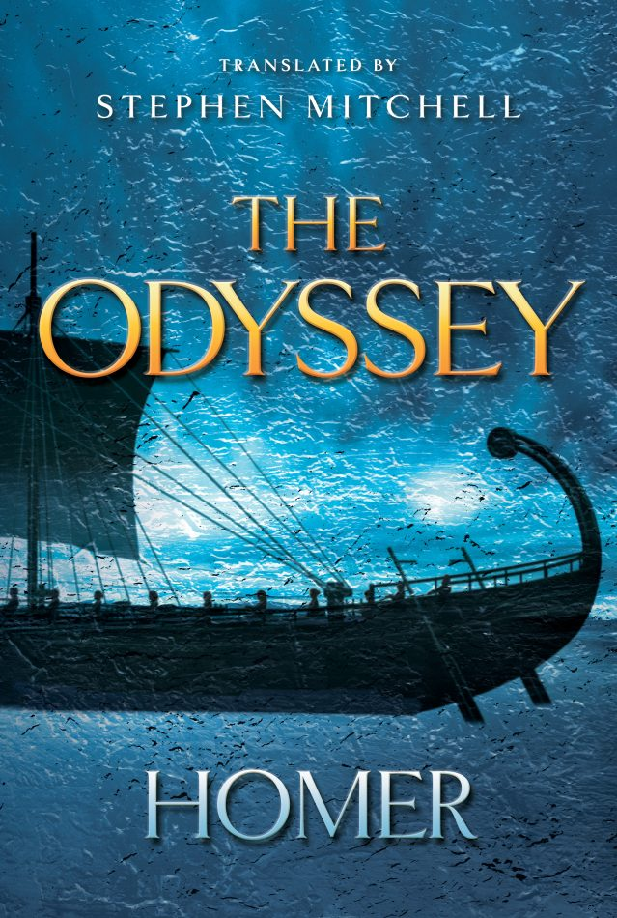
Knowledge Acquisition
Books are a rich source of information and can broaden one's understanding of various subjects.
Reading nonfiction can provide insights into history, science, and cultural perspectives.
A well-read individual often possesses a more informed worldview, enhancing their discussions.
Notes:
Image source: https://www.amreading.com

Slide 6

Social Benefits
Reading can foster connections through shared interests in books, leading to meaningful conversations.
Book clubs and reading groups offer opportunities for social interaction and community building.
Literature can bridge gaps between different cultures, promoting inclusivity and understanding.
Notes:
Image source: https://as1.ftcdn.net

Slide 7
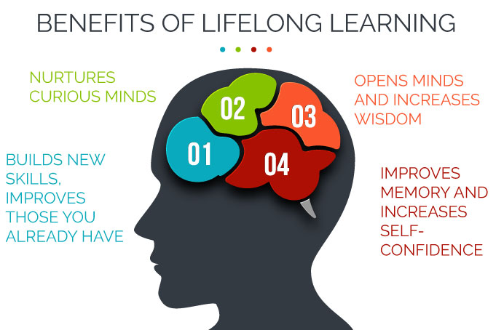
Lifelong Learning and Personal Growth
Reading encourages a habit of lifelong learning, which is essential in our rapidly changing world.
It can inspire creativity and innovation by exposing readers to new ideas and perspectives.
Ultimately, reading books contributes to personal development and a more fulfilling life.
Notes:
Image source: https://www.cilc.org

Slide 8
References
National Endowment for the Arts. (2007). To Read or Not to Read: A Question of National Consequence.
Stanovich, K. E. (2000). Progress in Understanding Reading: Scientific Foundations and New Frontiers.
Wolf, M. (2008). Proust and the Squid: The Story and Science of the Reading Brain.

